Slide 1
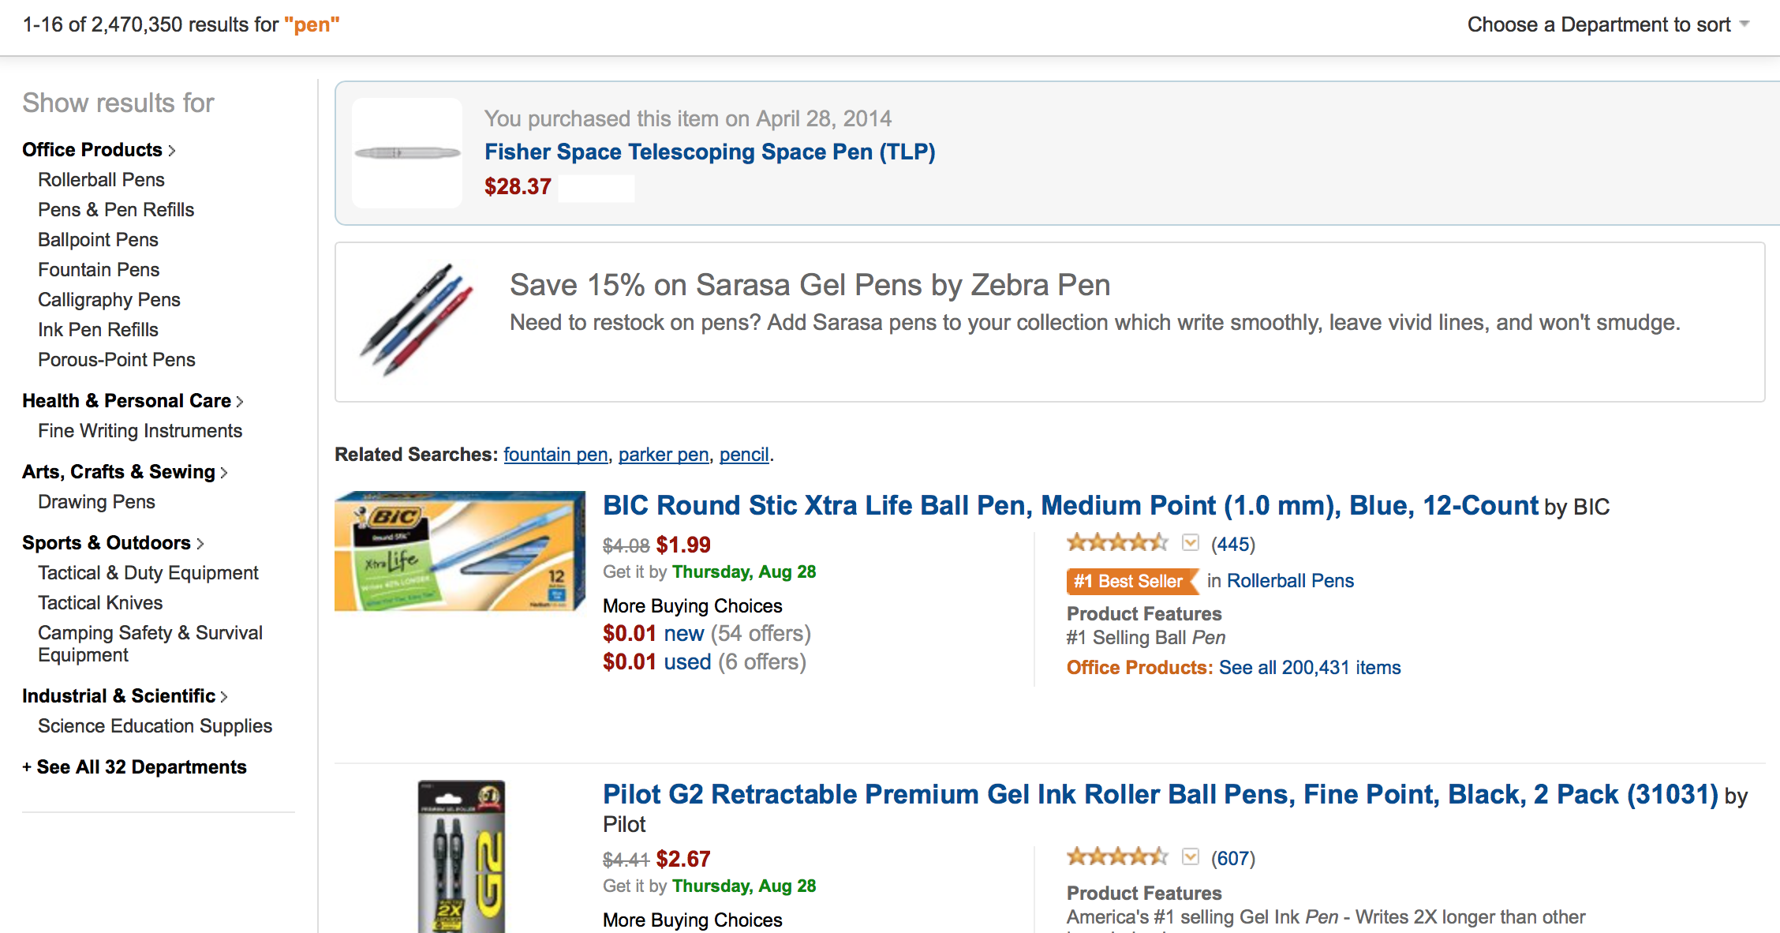
Product List
PRODUCT_LIST_HEADER
PRODUCT_LIST_CATEGORIES
PRODUCT_LIST_ITEMS
PRODUCT_LIST_PREVIOUS_PURCHASES
PRODUCT_LIST_PROMOTION
PRODUCT_LIST_RECOMMENDATIONS
PRODUCT_LIST_DETAIL
PRODUCT_LIST_DETAIL

Slide 2
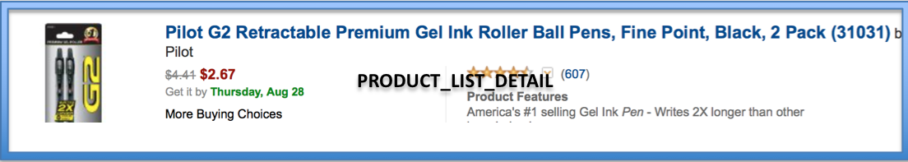
Name: PRODUCT_LIST_DETAIL Data: Actions: redirect_to_product_page redirect_to_more_buying_choices reviews_dropdown_render Configuration (content, images, etc.): image_thumbnail title_header_link manufacturer_span list_price (strikethrough) shipping_estimate_span more_buying_choices_link review_stars_image review_count_link review_dropdown product_features_label product_features_description
Component Definition

Slide 3
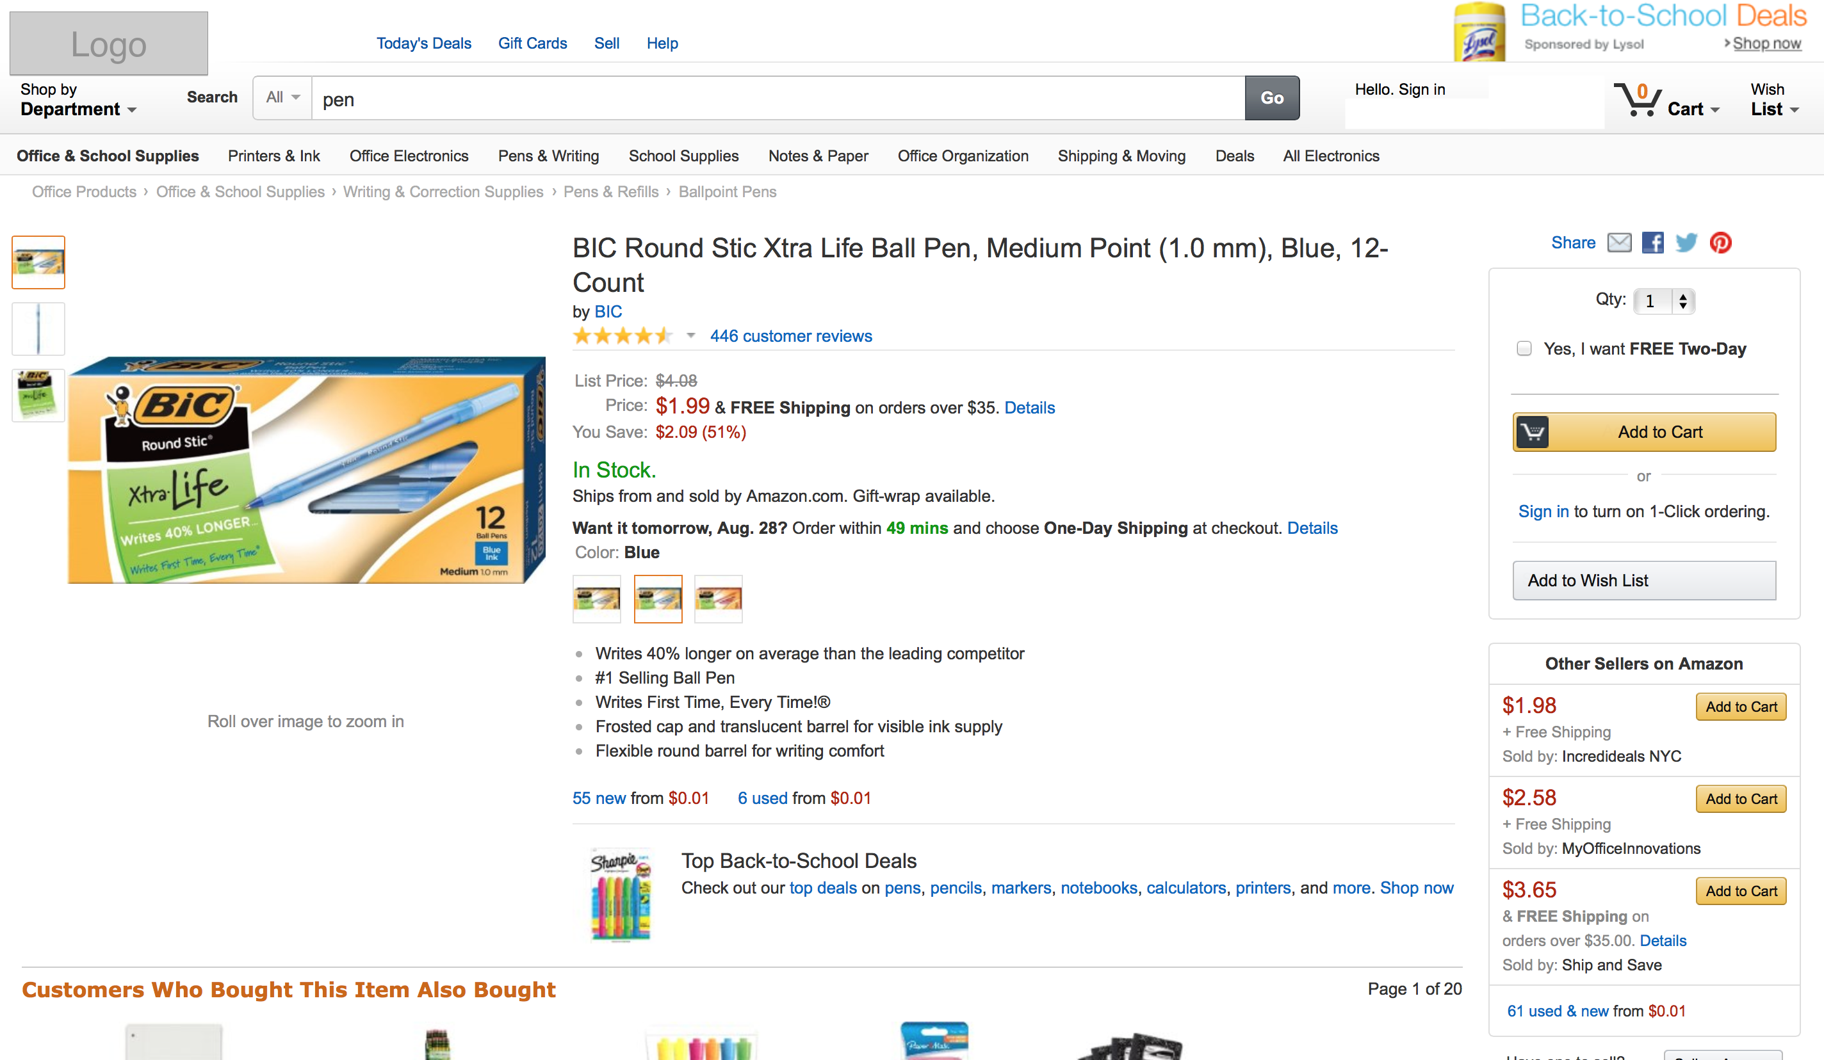
Product Details
NAV_HEADER
NAV_SEARCH
NAV_CATEGORIES
NAV_PATH
PRODUCT_DETAILS_GALLERY
PRODUCT_DETAILS_TITLE
PRODUCT_DETAILS_SHARE
PRODUCT_DETAILS_ORDERING
PRODUCT_DETAILS_DESCRIPTION
PRODUCT_DETAILS_SELLERS
PRODUCT_DETAILS_PROMOTIONS
PRODUCT_DETAILS_RECOMMENDATIONS

Slide 4
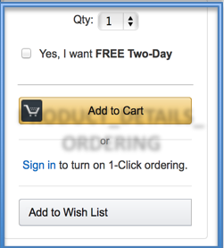
Name: PRODUCT_DETAILS_ORDERING Data: quantity two_day_shipping Actions: add_to_cart add_to_wishlist sign_in Configuration (content, images, etc.): quantity_select_label quantity_select_input two_day_checkbox_input two_day_checkbox_label hr_thematic_break_line add_to_cart_button add_to_cart_icon or_label_break_line sign_in_anchor sign_in_description wish_list_button
Component Definition

